Slide 1
Meeting Two
DPM Final Project
Fall 2017
Team 6
Status updates, mechanical design proposals, and preliminary software architecture

Slide 2
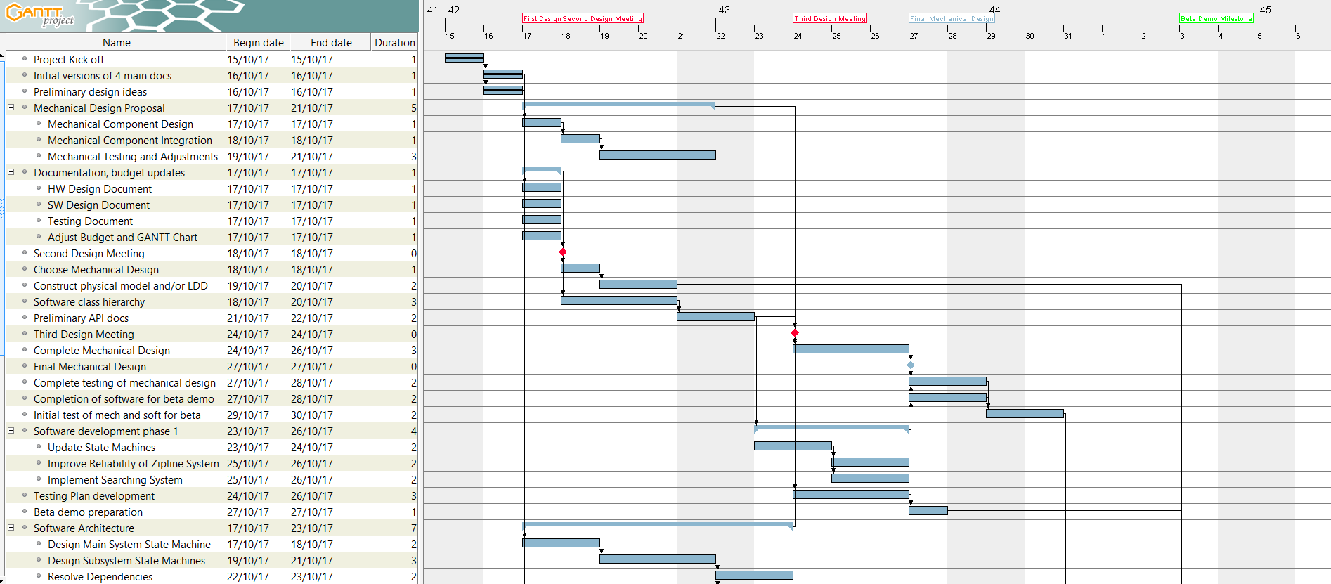
GANTT Chart Update

Slide 3
Budget Update

Slide 4
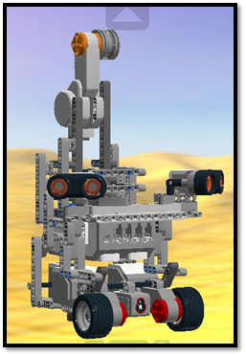
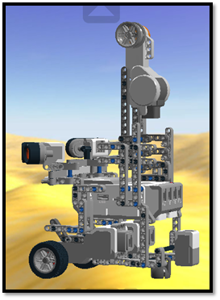
Mechanical Design Proposal – Option 1
Features
Set two ultrasonic sensors at 45 degrees in front of the robot.
Set one light sensor in front of the robot, between the two ultrasonic sensors, facing straight ahead.
Set the other light sensor as close as possible to the floor on the back of the robot, pointing downward for localization.
Set the EV3 brick horizontally (important for the balance point).
Set the wheels slightly larger than the width of the EV3 brick, with two motors.
PROS | CONS
Can detect a good range of distances since the two ultrasonic sensors are both oriented at a 45 degree angle. | No remaining ports for gyro sensor.
Only three motors; the weight is well-distributed. | Might fail to detect an obstacle at 180 degrees.
 | The two ultrasonic sensors might be set too high and give incorrect readings.
 | All the sensors are fixed.

Slide 5
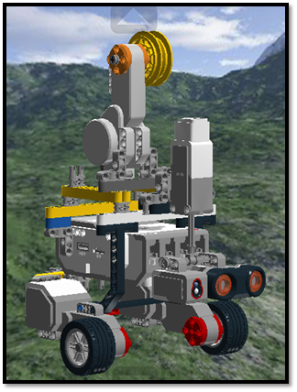
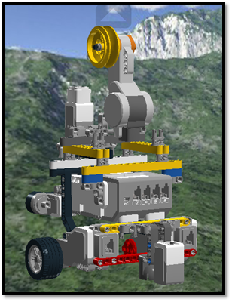
Mechanical Design Proposal – Option 2
Features
Set one ultrasonic sensor and one light sensors that are pivoting together in front of the robot. Use one medium motor.
Set one fixed light sensor as close as possible to the floor on the back of the robot, pointing downward for localization.
Set the EV3 block horizontally toward the front of the robot to avoid wheel slippage. As a result, we will need to add more weight toward the back for equilibrium. This robot will be heavier than the others.
PROS | CONS
The smallest robot, lower chance to hit obstacles during navigation or localization. | Height is too low.
The lightest robot, less supporting pressure on both motors. | Supporting arm needs revision.
Light and US sensors attached together, more efficient in detecting obstacles and targets.

Slide 6
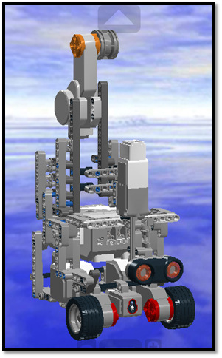
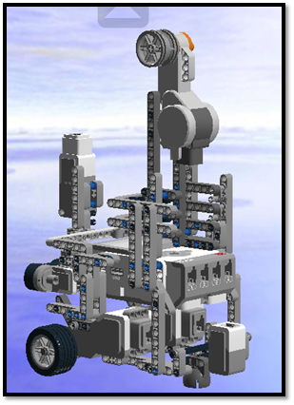
Mechanical Design Proposal – Option 3
Features
Set only one ultrasonic sensor in front of the robot that is pivoting. We will have to use one medium motor.
Set one fixed light sensor in front of the robot that is facing straight ahead.
Set one light sensor as close as possible to the floor on the back of the robot, pointing downward for localization.
PROS | CONS
Both the ultrasonic and light sensors positioned in front are low enough. | The stability of the arm should be revised.
The ultrasonic sensor can be moved. | The light sensor is not attached to the ultrasonic sensor, so it can’t pivot and is less efficient for detecting the object’s color.
Simple design, leaves one spare port for the gyro sensor if necessary.

Slide 7
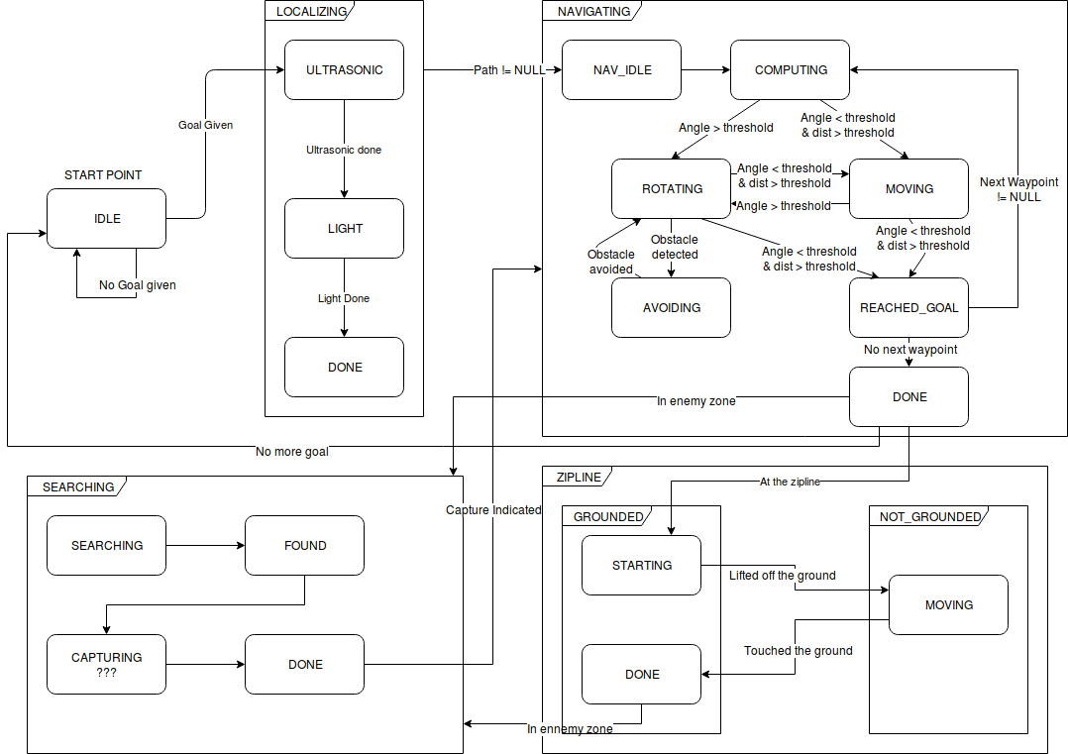
Software Architecture – State Machine System

Slide 8
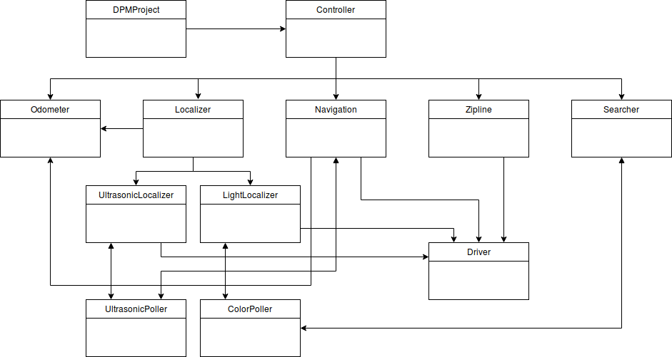
Software Architecture – Class Hierarchy

Slide 9
Lab 5 Results
Design presentation (5/5)
team successfully answered all questions
Pose orientation accuracy (0/2.5)
robot orientation was greater than 2º away from zip line axis
Pose position accuracy (2.5/2.5)
robot position reached (X_{o}, Y_{o}) within the 2 cm error tolerance
Zip line traversal (0/20)
the zip line wheel was not oriented closely enough with the zip line, giving the robot no chance to mount or traverse the zipline.
note: our testing showed that the robot was capable of mounting, crossing, and stopping after dismounting the zipline, but it had no chance to do so in the demo because the robot’s localization and navigation were not accurate enough to get the robot to the start of the zip line

Slide 10
Week 2 Plan
Finish Lab 5 software; prepare documents for team meeting #2
Test and demo Lab 5; team meeting #2
Write Lab 5 report; document improvements required after Lab 5 performance
Test and finalize mechanical design
Finalize state machine and software structure
Prepare documents for team meeting #3 (milestone #1)

